Slide 1

Crafting a Blockbuster
Notes:
NICOLE

Slide 2





Who’s presenting?
Karen
Dominguez
Nicole Pastor
Emma
Ramey
Isael
Corona
Fav Genre: Drama
Fav Movie: Ironclaw
Fav Genre: Action / Comedy
Fav Movie: Top Gun Maverick
Fav Genre: Horror/ Black Comedy
Fav Movie: In Bruges
Fav Genre: Adventure
Fav Movie: La Haine and Star Wars Episode 3 (Tie)
Start
Notes:
All

Slide 3

Objective
Client: Netflix Studios, executives.
Using data of movies released between 2012 and 2016, what type of movie should Netflix make next?
Data Breakdown :
Actors
Directors
Genre
Revenue
Data Source: Provided by COOP
Notes:
Karen

Slide 4
Methodology
Measurement of Success
Box Office Profit & Net Film Revenue
Data Analyzed
Box Office performance of 509 films from 2012 to 2016 for movies that grossed over $1,000,000 with a budget of at least $1,000,000 as well as the top 10 actors and directors who had the most top performing films
Notes:
One million. A strange way the box office data structured is that if a movie is animated the genre is not always listed as animation. The genre is listed

Slide 5
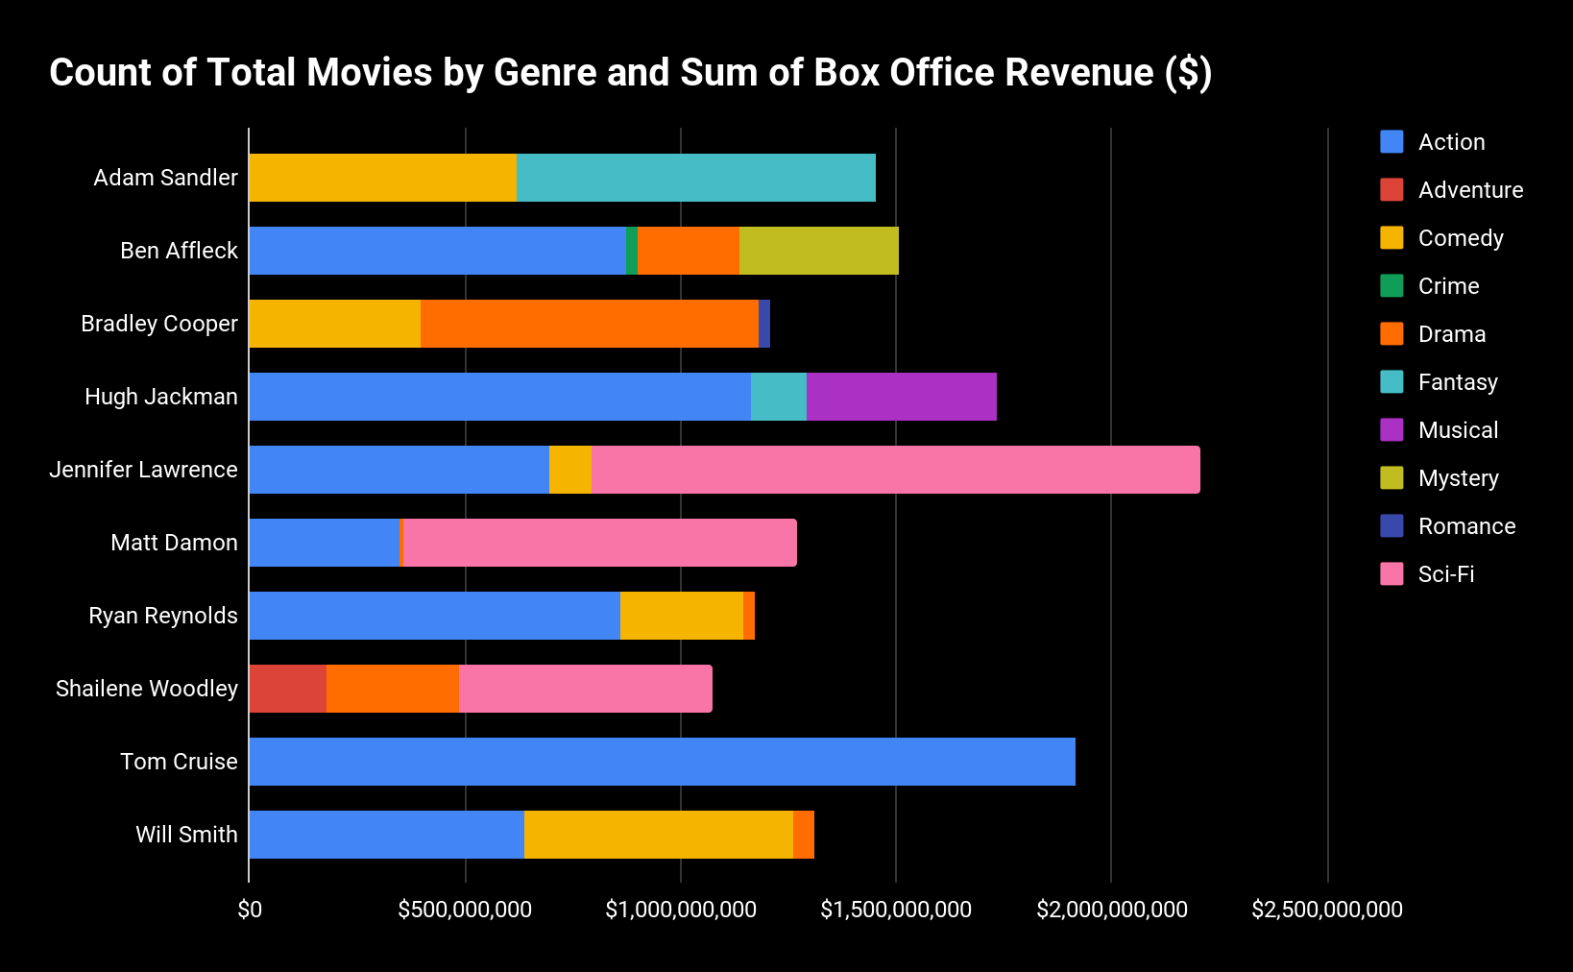
Top 10 Grossing Actors & Box Office Revenue 2012-2016)
Key Insights
Jennifer Lawrence grossed approximately 2.2 million dollars at the Box Office between 2012-2016
Lead actors for potential new projects should feature: Jennifer Lawrence, Tom Cruise, Hugh Jackman in the starring/ main cast as they are the top three grossing actors across the board
Lawrence’s Sci-Fi movies were most successfully at the box office
Notes:
Karen

Slide 6
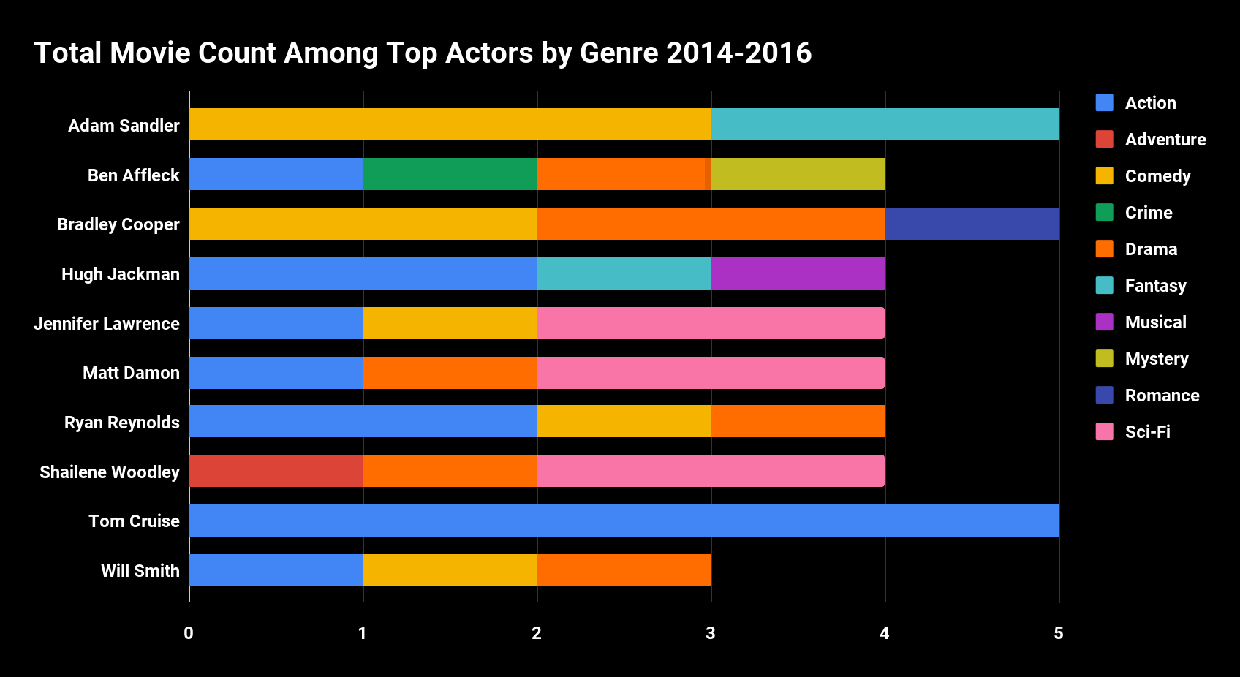
Top Actors & Movies Made across most popular Genres in 2014-2016
Top Actors are most likely to star in Action movies.
Tom Cruise starred in five action movies meanwhile Jennifer Lawrence starred in four movies in three different genres: Action, Comedy, and Sci-Fi
Notes:
Tom Cruise had five movies and only all movies in the Action category. It can be said that Cruise will bring in high Box Office revenue among the Action genre.

Slide 7
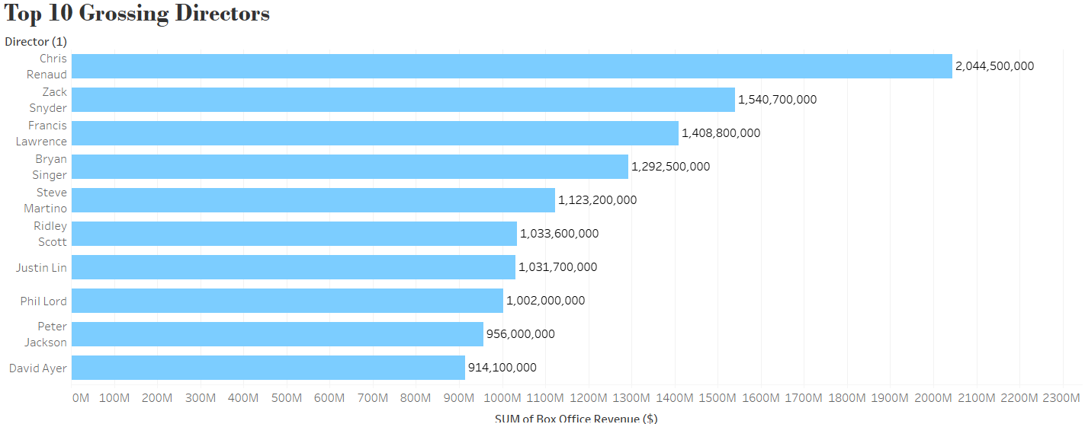
Top 10 Grossing Directors (Box Office Revenue 2012-2016)
Chris Renaud is the highest grossing director with over 2 billion and 44 million in box office revenue
Chris Renaud, Zack Snyder, and Francis Lawrence are the top 3 Directors
Zack Snyder, and Francis Lawrence box office revenue was around 1 billion and the 400 to 500 million mark
Notes:
Chris Renaud shows an impressive amount of box office revenue from the movies he directed, grossing over 2 billion and 44 million

Slide 8
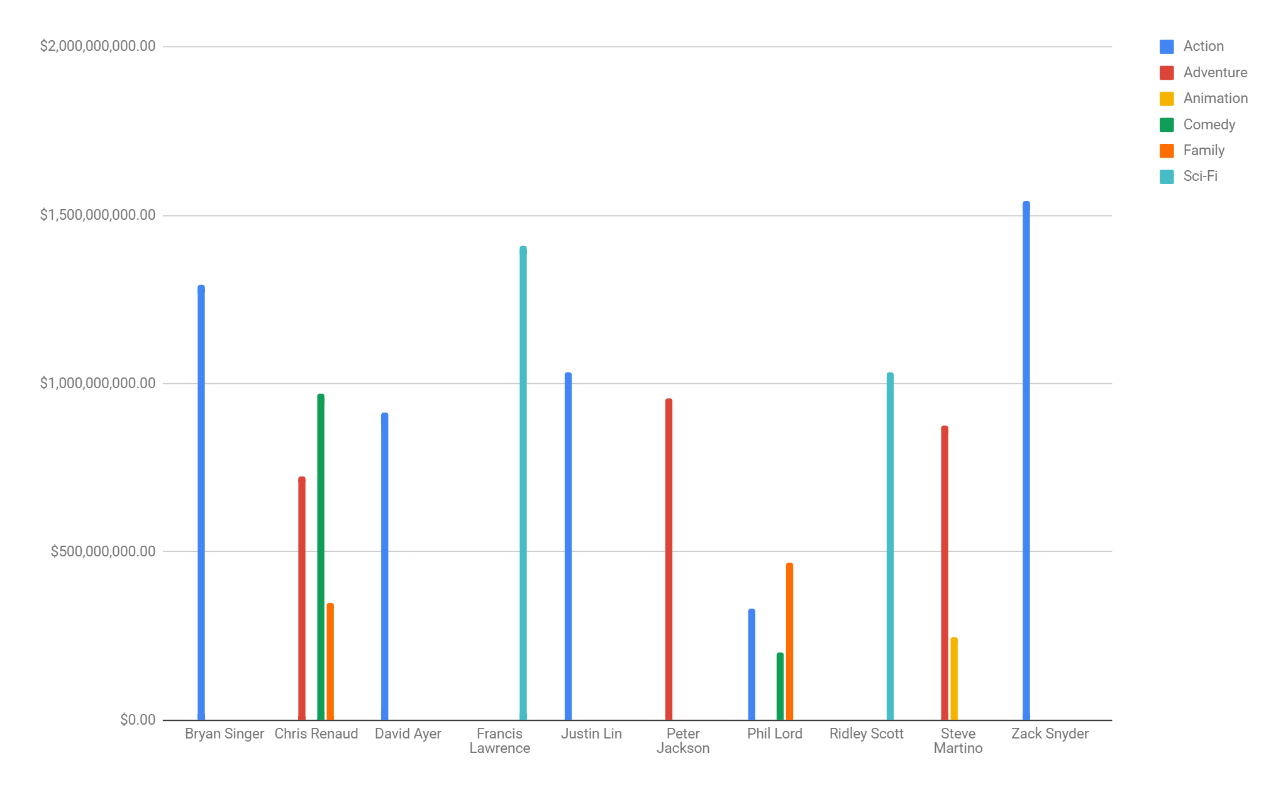
Directors x Genre
5 Directors did the Genre Action
Chris Renaud (Top Grossing Director) did Comedy, Adventure, and Family.
Zack & Francis did 1 movie and received great success.
Notes:
Director x Genre
In this chart, each line shows the type of movie genre the director did,
The popular genre that the majority of the top 10 directors have done Action,
Chris Renaud for instance, (who was the Highest grossing director) did 3 types of movies. He did Comedy (which estimated 900 M) , Adventure (700 M) , and Family (350 M)
Another interesting note to add is that Zack Snyder (2nd highest grossing director) did 1 movie which resulted in 1 billion 500 million - action movie

Slide 9
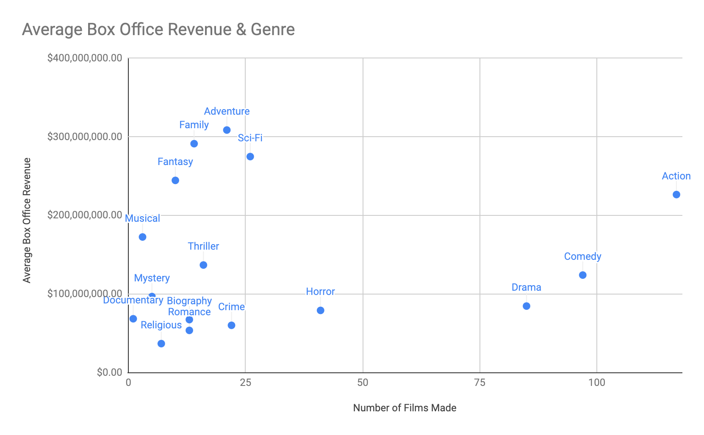
Genre
Despite having the most movies produced (113) Action movies place 5th on average box office revenue.
Fantasy, Family, Adventure and Sci-Fi were the average top grossing genres.
Notes:
We analyzed data of the top grossing movies from 2012 and 2016. X axis shows the number of films made in that genre between 2012 and 2016 and the y-axis shows the average box office revenue of those films.
Action movies - popular with a wide range of budgets.

Slide 10
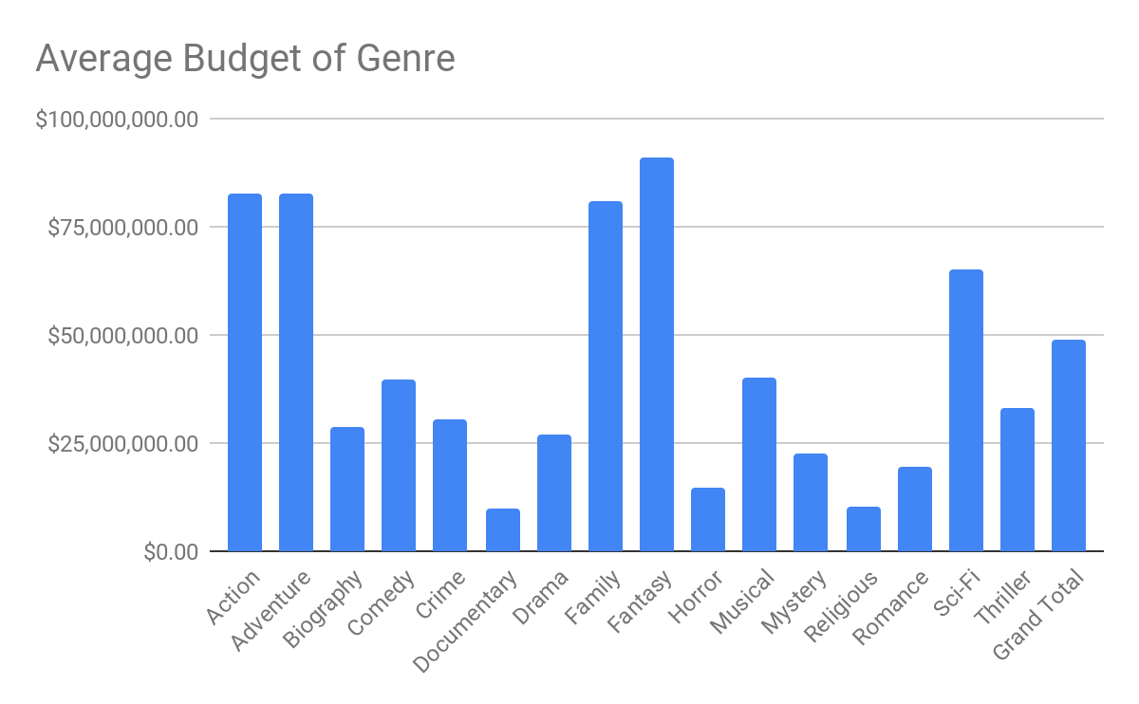
Average Budget by Genre
The cheapest average budget is documentary with a cost of $10,000,000
The most expensive average budget is fantasy with a cost of $91,000,000
The average budget of all genres is $48,871,397.64
Notes:
For both graphs I decided that the x axis would represent the genre and the y axis represent the money whether being budget or profit. - When considering how successful a genre is I first looked at the average cost of genre because we need to get the revenue of those genres

Slide 11
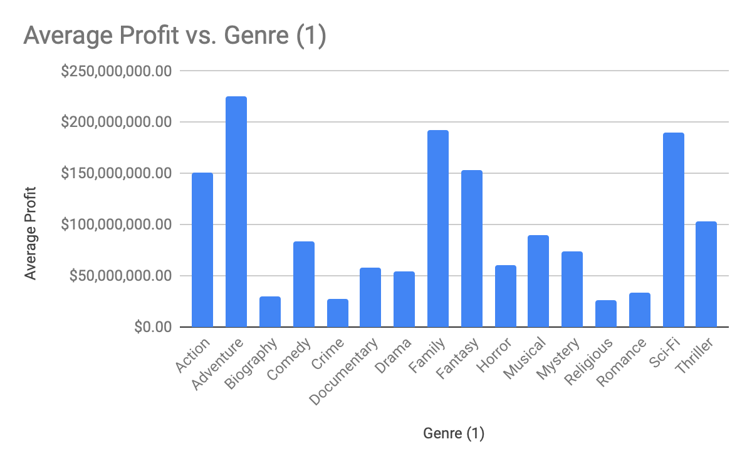
Average Profit by Genre
The genre that had the highest profit was Adventure
Profit vs Box Office
The best genres to maximize money Adventure, Family, Fantasy and Sci-Fi
Even though some genres didn’t make much they did get good ROI’s such as Documentary and Horror
Notes:
-Some movies in the adventure, family, sci-fi and action genre where animated. Therefore it shows that animated movies are successful in bringing profit
-I took the average box office and I subtracted it from the average cost to get profit - Some movies had high box office numbers but didn’t have as good
Roi’s such as documentary at 6.85 and horror 5.15

Slide 12

Notes:
For our conclusion we will share 3 recommendations on what the next Netflix’s movie project should be.

Slide 13

Recommendations
Animation: Overall best net profit vs budget. High Budget
For a tight budget, Horror & Documentary: not as popular but high returns on low budget
Consider Jennifer Lawrence as your main cast, specifically in Sci-Fi projects. For directors, Zack for Action and Chris for others.
Notes:
Emma- 1
Top Genres that made the highest average profit between 2012 and 2016 were Adventure, Family, Sci-Fi and Fantasy. Films that were in that genres included films that were animated. We would recommend pursuing Animation films. Animation films can vary widely on tone and are enjoyed by people of many ages. To hit the most popular genres we recommend making a animated family aadventure movie. Animated films have a high budget, but with proper marketing and promotion there is a high potential to pull a large profit as well as additional revenue through merchandising.
Isael- 2, Nicole/ Karen - 3 as she had the highest sum of box office revenue during 2014-2016

Slide 14

Notes:
Questions or Comments from audience -Isael

Slide 15



